Slide 1
REVOLUTIONIZING HIGHER EDUCATION
20TH PATEF-UPDATE
Century Park Hotel
May 17 2023

Slide 2
WHY TALK ABOUT THE FUTURE?
Environment is changing.
Success is not permanent.
Old rules no longer apply.
WE NEED TO ADAPT, LEARN AND BE CREATIVE IN ORDER FOR US TO SUCCEED.

Slide 3
The State of Philippine Education Based on International Assessments
90% of children aged 10 years old could not read
We have been in a learning crisis for a while now.
The Philippines is last on reading and second to last in Mathematics and Science among 79 participating countries. (PISA)
Last in both Mathematics and Science among 64 Participating countries.(TIMSS)

Slide 4
The State of Philippine Education Based on International Assessments
Filipino students spend more time in school but are less productive with an estimated learning gap of 5.5 years
Completion rate for secondary education significantly drops to 30.5 %
Completion rate for a Bachelor’s degree decreases further to 24.4%

Slide 5
Why are we here?

Slide 6
Why are we here?
Out of 4 kinder-aged children are not attending pre-school.
There is pre-valence of malnutrition wherein in every 3 children under the age of 5 are stunted.
Lack of good nutritional and learning foundation translates to a chain of learning losses

Slide 7
Why are we here?
Mother tounge-based multilingual education brought nothing but frustration and confusion to parents, students and teachers
Inaccurate and insufficient language mapping and lack of translated materials
Underemployment is experienced by 15.4 % of our workforce as of Sept, 2022

Slide 8
Why are we here?
7.33 Million people are unable to fully utilize their skills in their present jobs
Six out of 10 Filipinos are using their general skills working as service, clerical and support workers
Lack of productivity of our workforce.

Slide 9
DATA IN REVIEW
on Learning Poverty and Literacy in the Philippines

Slide 10
PISA 2018
○ The Philippines ranked last among 79 participating countries and economies in reading and second to last in science and mathematics.
○ At least 78% of students in the Philippines failed to reach minimum levels of proficiency in each of the three PISA subjects.
■ 19% achieved the minimum proficiency level of Overall ReadingLiteracy.
■ 19% achieved the minimum proficiency level of Overall Math Literacy, Level 2 or higher.
■ 22% of students attained Level 2 or higher in Science.
Data in Review on Learning Poverty and Literacy in the Philippines
Source: Philippine Business for Education Higher Education Summit 2023

Slide 11
Data in Review on Learning Poverty and Literacy in the Philippines
In a study conducted by the World Bank in 2021, it reported that learning poverty in the Philippines was estimated at 90.9% in 2019.
Below shows that learning poverty in the Philippines is 55.9% higher than the average for East Asia and Pacific region and 30% higher than the average for lower middle income countries
Source: Philippine Business for Education Higher Education Summit 2023

Slide 12
Data in Review on Learning Poverty and Literacy in the Philippines
The Philippines has an estimated learning gap of about 5.5 years, as illustrated in the Figure below. The learning gap is larger than its neighbors. This finding can be interpreted to mean that an average Filipino student spent more time in school but was less productive than their counterparts in comparator countries.
Source: Philippine Business for Education Higher Education Summit 2023

Slide 13
REVOLUTIONIZING HIGHER EDUCATION

Slide 14
CURRENT REALITIES
QUALITY IS NON-NEGOTIABLE; IT IS COMPELLING
CERTAINLY, QUALITY IS COMPROMISED
SEAMLESSNESS IN QUALITY
PORTABILITY FOR LEARNING COMPETENCY

Slide 15
CURRENT REALITIES
Delay in Achieving UN Sustainable Goal 4
Covid 19 Pandemic and Education
Technology
Teacher Capacities
Inequalities

Slide 16
CURRENT REALITIES
Emerging Landscape
Range of New On Line Courses
Increase Use of Open Education Resources (OER)
New Ways of Student Assessment

Slide 17
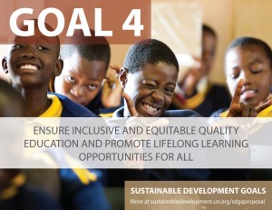
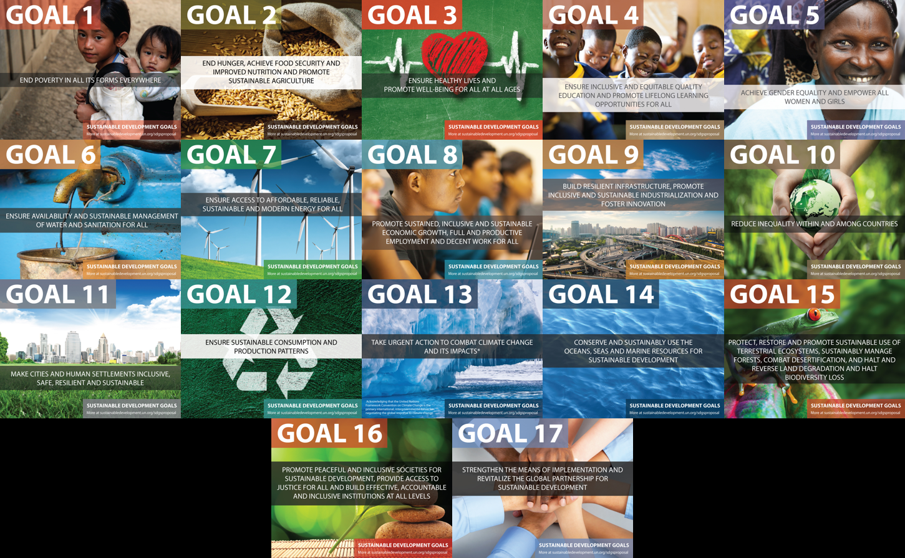
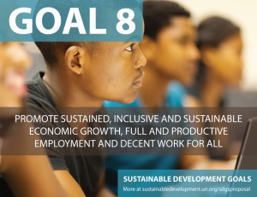
17 UN Sustainable Development Goals

Slide 18
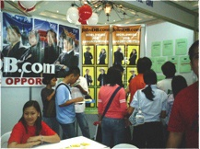
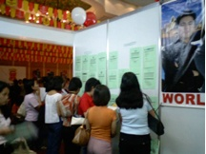
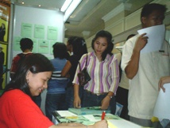
The Unemployed
Unemployed are mostly young, unskilled, inexperienced, males, in the urban areas
Youth accounts for almost half of total unemployed
Spent more years in college than the employed
Incidence of unemployment tends to increase with years of education

Slide 19
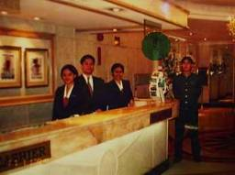
Driving Graduate Unemployment
failure in the examination or interview
poor communication skills;
residence of the applicant is far from the jobsite;
lack of extensive work experience; and
inconsistency in the submitted information and documents vis-à-vis claims of the applicants.
Is there
HOPE ?

Slide 20
BREAKING WALLS
BRIDGING GAPS

Slide 21
The Complete FILIPINO Student
SOCIAL
Student-centric administrative services
Co-curricular activities
Social/cultural facilities & equipment
ACADEMIC
Faculty
Curriculum
Learning materials
Facilities
Industry partners
AT THE CENTER OF EVERYTHING WE DO

Slide 22
Embracing the Future
Diversity
Equity
Inclusion

Slide 23
TRENDS IN HIGHER EDUCATION
Learning from Everywhere
Replacing Lectures with Active Learning
Teaching skills that remain relevant in a changing world.
Using formative assessment instead of high-stake exams.

Slide 24
PARTHWAYS TO 2050 AND BEYOND
Quality of Life
Social Change
Care of Environment
Development of Technology

Slide 25
HIGHER EDUCATION IN 2050
Higher Education for All
Student Centered
Organization of Knowledge
Connected at Multiple Levels

Slide 26
Moving forward…
Setting up of Education Management Information System (EMIS)
Revolutionize Early Childhood Development Education plus PWD
Inventory of Education Programs and Strategies in the Philippines.
Teacher’s Training and Incentives Programs

Slide 27
Call to Action
Advocate for the right to higher education
Address the barriers that limit participation
Open up access to knowledge
Empower the next generations
Strive for higher education to be more relevant
Become a futures thinker.

Slide 28
TEACHING IS NOT AN ACCIDENT!
FUTURE PROOFING
VALUES
VISION
CHANGE
LEADERSHIP
TEAMWORK

Slide 30
Secretary Herminio B. Coloma, Jr. Executive Vice President, Manila Bulletin
“Many years from now, it will not matter how much wealth or riches we may have accumulated, but the world will be a better place because we made a difference in the lives of the people that we have served”

Slide 32
“A Godless education is an end without a beginning.”
JOSE P. LAUREL
PRESIDENT, REPUBLIC OF THE PHILIPPINES

Slide 33
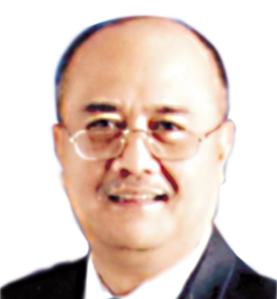
“who we are whom we are for and what we have to do for those for whom we are.” Prof. Tomas Lopez Jr.
We must never forget

Slide 34
Revolution in the education system is necessary if we are to use education in promoting equal opportunity to learn and in building social capital!

Slide 35
A Revolution is Necessary
Even for good schools, the time to change is NOW
And change must not be merely reformative: it needs to be truly TRANSFORMATIVE (and that means: REVOLUTIONARY)
Change has to be achieved first in the field of ideas, in our “mindsets”
Eduardo O C Chaves
Coordinator,UNESCO Chair of Education and Human Development at the Ayrton Senna Foundation (São Paulo, Brazil)
Member, Microsoft International Advisory Council for Partners in Learning

Slide 36
REVOLUTIONIZING EDUCATION
We must:
Re-conceive education
Redefine learning; and so,
Reinvent schooling
Eduardo O C Chaves
Coordinator,UNESCO Chair of Education and Human Development at the Ayrton Senna Foundation (São Paulo, Brazil)
Member, Microsoft International Advisory Council for Partners in Learning

Slide 37
Are we willing to stage this REVOLUTION?

